Slide 1
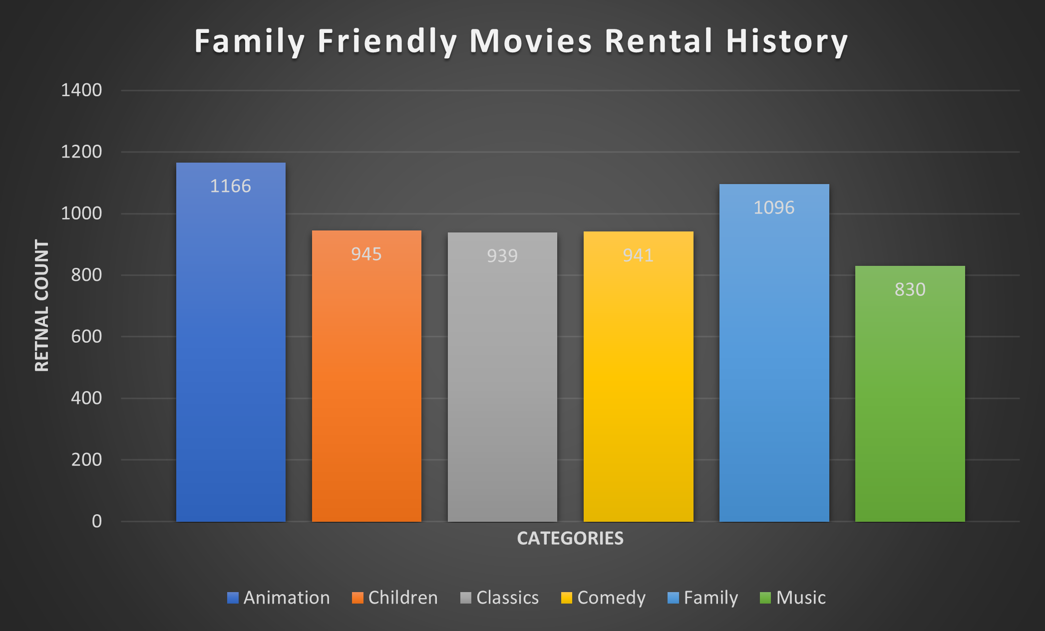
What are the top three most rented family friendly movie categories?
<visualization>
As we can see from the graphic, the Animation, Family and Children are the top three most rented family friendly movie categories.

Slide 2
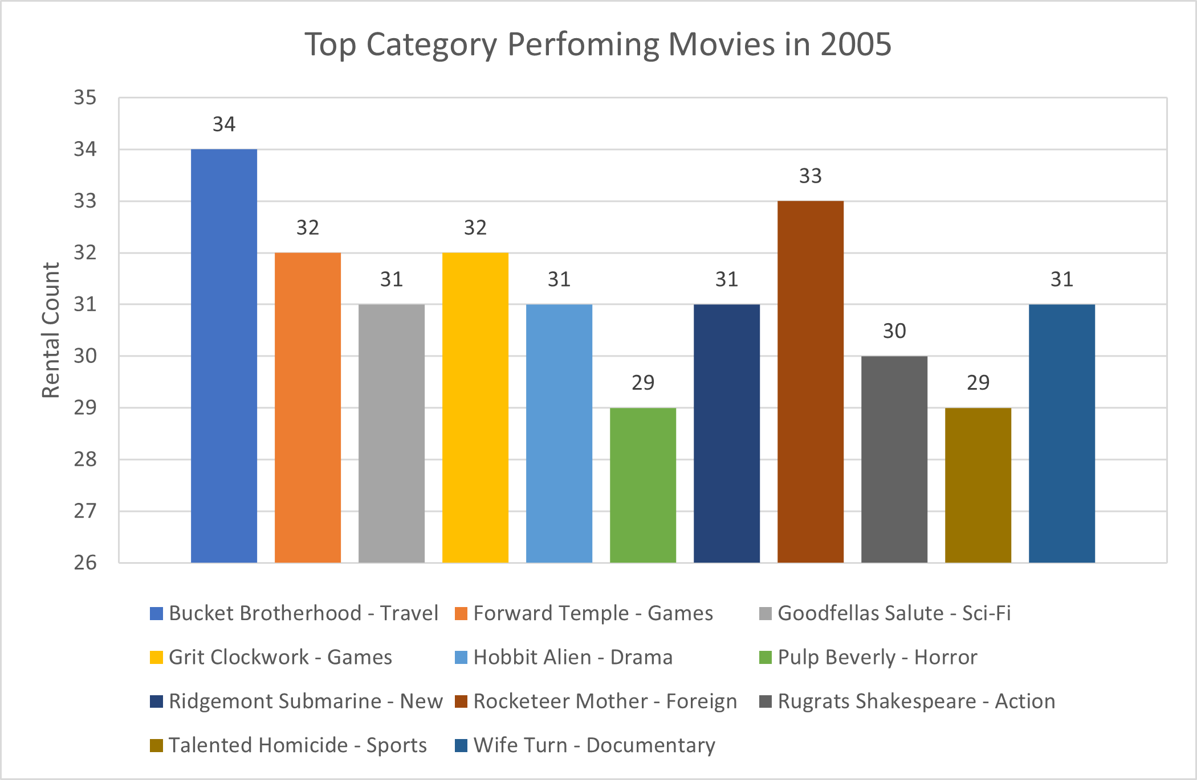
Find the top performing movie(s) in terms of rentals for each of the non-family friendly category in the year 2005. Which are the top three categories based on the number of rentals?
<visualization>
The Travel, Foreign and Games categories were the top three non-family friendly categories in 2005 based on the number of rentals.

Slide 3
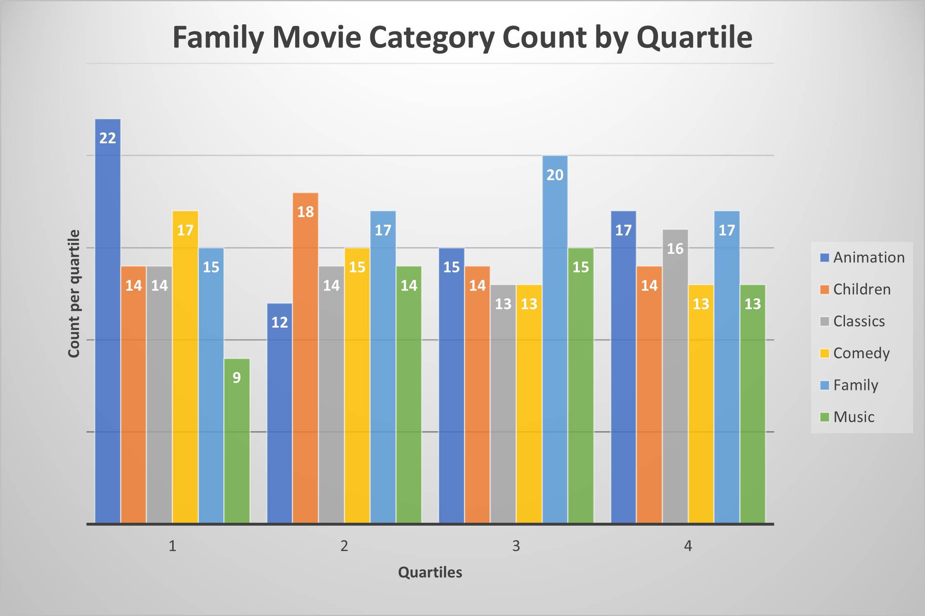
Provide a chart showing the family-friendly film category, each of the quartiles, and the corresponding count of movies within each combination of film category for each corresponding rental duration category. Identify the category with the highest count on each quartile.
<visualization>
The Animation category has the highest count in the first quatile and it is tied with the Family category in the fourth quartile. The Children category takes the highest spot on the second quartile while the Family category has the highest count in the third quartile.

Slide 4
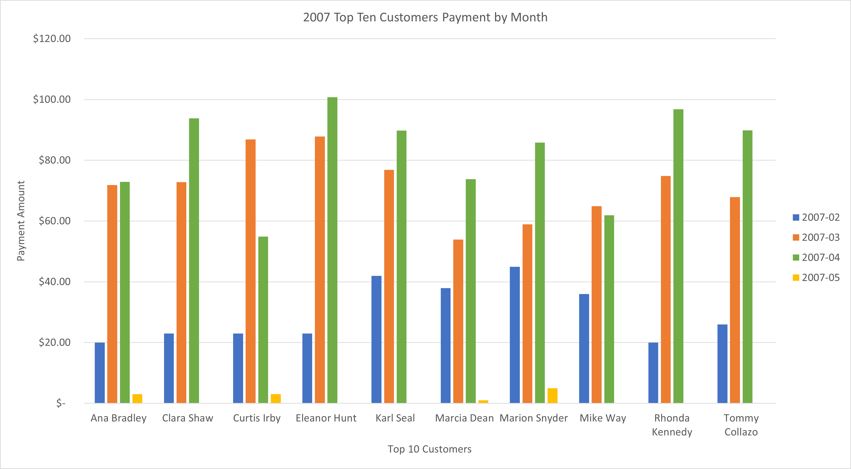
For each of the top 10 paying customers, I would like to find out the difference across their monthly payments during 2007. Please go ahead and write a query to compare the payment amounts in each successive month. Repeat this for each of these 10 paying customers. Also, it will be tremendously helpful if you can identify the customer name who paid the most difference in terms of payments.
<visualization>
Eleanor Hunt paid the most difference in terms of payment. She paid a difference of $64.87 between March and February of 2007. Curtis Irby paid $63.89 in the same period. We can see how close their difference was in the bar representing the paid amount for both Eleanor and Curtis for the months of Feb and Mar of 2007.

